Slide 1
Analytic Frameworks for Student Organizations: Exploring 3 Years of Data at DSI
Tyler Richards - DSI President
@tylerjrichards

Slide 2
Personal Background
2014-2018: Undergrad, Industrial and Systems Engineering
Summers of 2017 + 2018: Data Scientist, P&G
2017-2018: DSI Workshop Coordinator
2018: DSI President
Spring 2019: Data Scientist, VoteShield
Post Spring 2019: Data Scientist: Facebook

Slide 3
DSI: Data Science and Informatics
1st Student-Run DS Organization at UF
Host Data Science Workshops
2500+ Workshop Attendances over ~3 years

Slide 4
Tableau
Actuary
SQL
R0
Spark
Data Visualization
Practical Data Science
Machine Learning in Python
Natural Language Processing
Python 1
Data APIs
R1
Statistics for Data Scientists
Hadoop
Python 0
Machine Learning in R

Slide 5
“What kind of idiot would I be if I ran a Data Science Organization without applying Data Science”
–Me, 30 minutes after I got elected

Slide 6
Who Cares about this Talk
People Who:
Are running their own organizations
Work with data and want to avoid similar pitfalls
Like pretty graphs

Slide 7
DSI: 3 Projects
The Outsized Returns of Reproducible Data Collection
Turning Exploratory Data Analysis into Insights
Failed Projects are just Future Projects

Slide 8
Data Collection at DSI
Sign-In Sheets
~95% Utilization
Collect timestamp, name, gender, workshop type, major, year etc

Slide 9
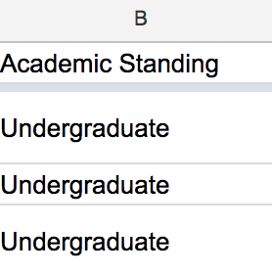
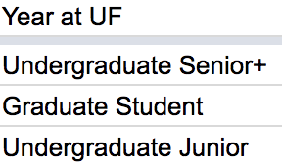
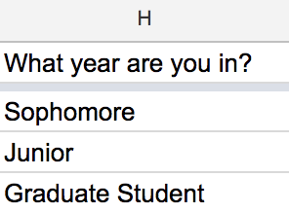
Non-Reproducible Data Collection

Slide 10
Non-Reproducible Data Collection
E Mail
Contact (Email)
Email
EMail
E-Mail

Slide 11
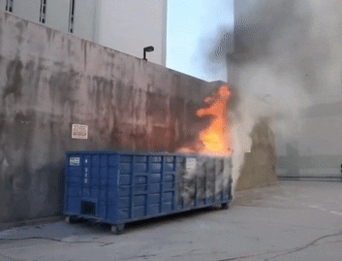
Non-Reproducible Data Collection

Slide 12

Best Practices: Data Collection
Standardize Standardize Standardize
Outsized returns: 10x time 50x stress
D
Share Scripts, not PII
Use GitHub!!!!
.gitignore is a good friend

Slide 13
Collect Data at Workshops
Sheets API in R (GoogleSheets Package)
Analyze and Visualize
Push to Github

Slide 14
Turning Exploratory Data Analysis into Insights
Good EDA is:
Mission Driven
Inquisitive
Graph Heavy

Slide 15
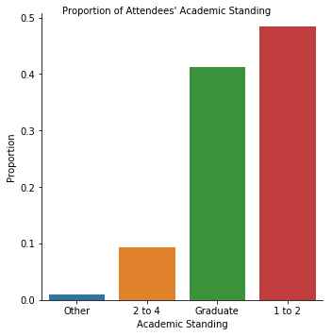
Standing of Workshop Attendees

Slide 16
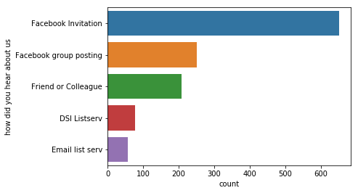
All Hail Facebook

Slide 17
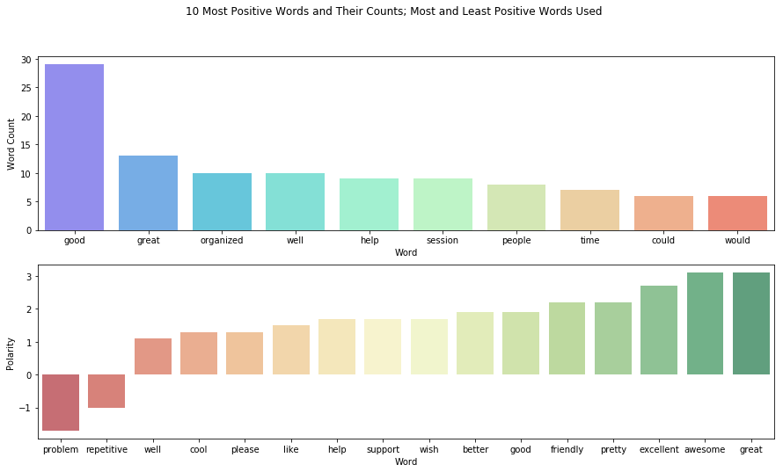
Word Count + Polarity

Slide 18
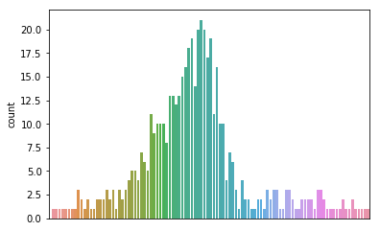
College Students are Normally Late

Slide 19
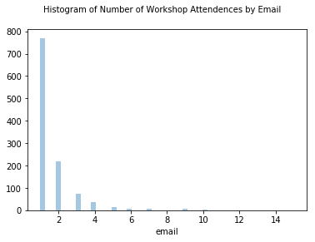
DSI’s Mission
2015 - Present: Learn and Teach as Fast as We Can
Result:
Lots of reason to come, few reasons to stay

Slide 20
DSI’s Current Mission
Present: Learn and Teach as Fast as We Can
Create a Data Science Community

Slide 21
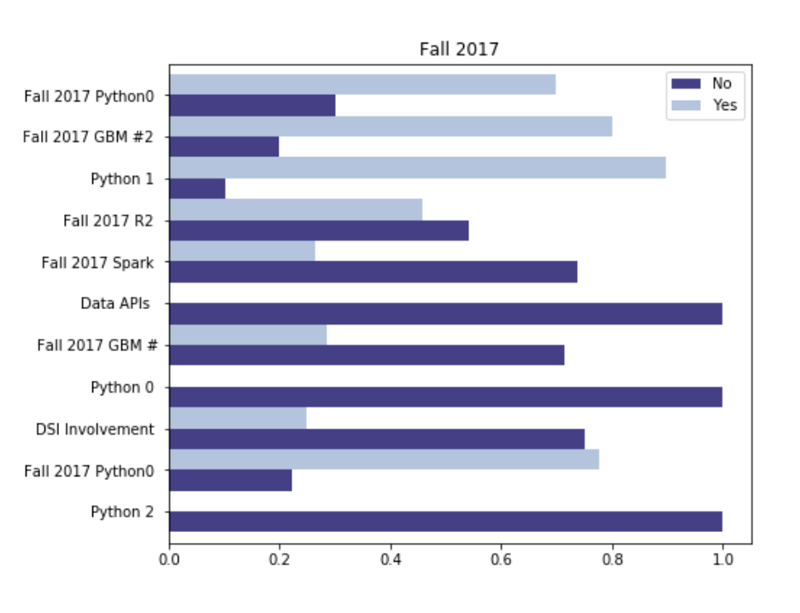

What Brings People Back?
Fall 2017: Asked “is this your first workshop”

Slide 22
Insight to Action
Curriculum Development
Statistics for Data Scientists
Actuary
Tableau
Practical Data Science
ML in R

Slide 23
Insight to Action
Community = Food + Space + Data

Slide 24
Data Science Wednesday
No structure
No lecture
No purpose
Data, Pizza, Space

Slide 25
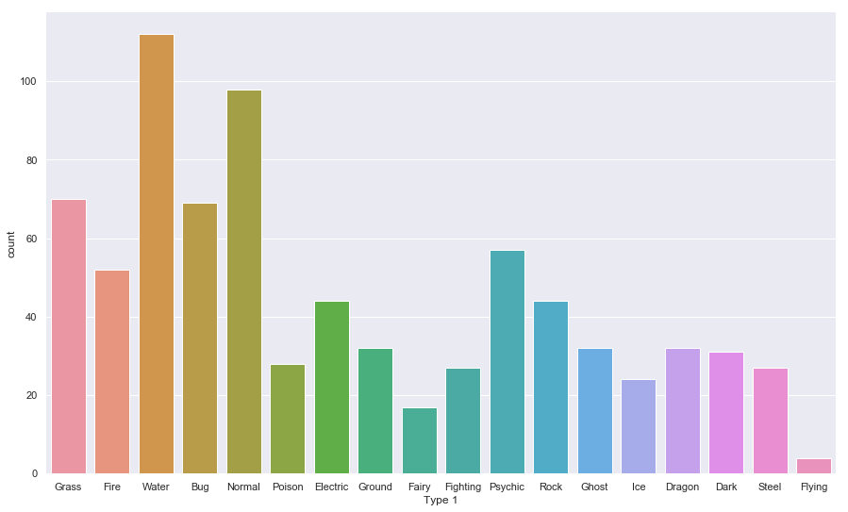
Pokemon by Type

Slide 26
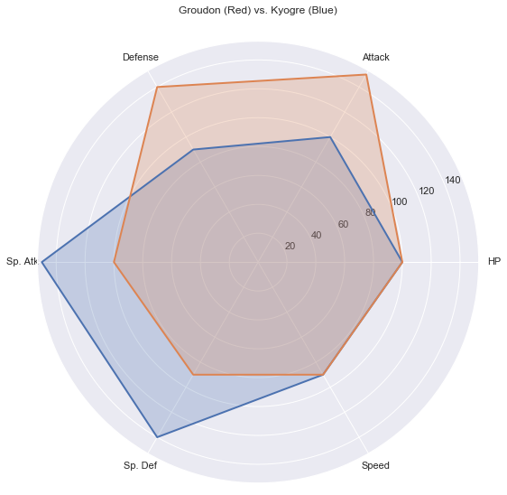
More Pokemon Visualizations

Slide 27
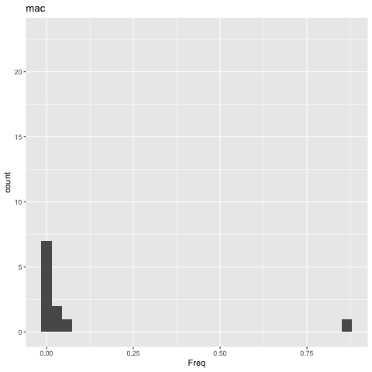
gganimate: Visualizing number of R Downloads by OS

Slide 28
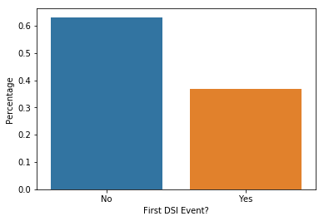
Fall 2018: Results
Total Attendance: 530
Largest % Return Attendees

Slide 29
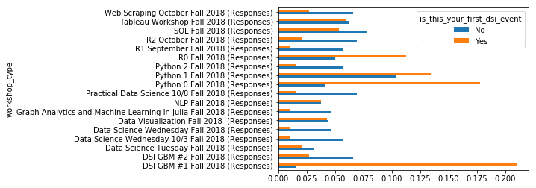
Insight to Action

Slide 30
“Failed”/Future Projects at DSI

Slide 31
Projects
Predict the Pizza: A Shiny App for forecasting attendance
~72 workshops
Adj R^2 = .26
A/B testing for Workshops
Python 0 -> Python 1

Slide 32
The End!
Special Thanks to Delaney Gomen

